Slide 1

B-Foundations of NoSQL

Slide 2
AGENDA
Why Data is important?
Criticisms of Relational
Scalability / Distributed Databases
ACID vs BASE
Non-Relational Models
Polyglot Persistence

Slide 3
The Importance of Data

Slide 4
Questions?
Why are Facebook, Google, and Twitter free services?
Why do companies like Target, Starbucks, and Verizon have customer rewards programs?
What makes rideshare services like Uber or Lyft more efficient than taxis?
DATA
Notes:
In the case of Facebook, Google and twitter, we offer personal information about ourselves including what we are doing in our lives in exchange for use of their services. In turn these companies use this data to better market to us. This is similar with rewards programs from companies like Target, Starbucks and Verison, only they use our spending habits to market product and services. Data about customers using the ride share services is what makes them more efficient that taxi companies.

Slide 5
Two Kinds Of Data
Reference-Oriented Data
Data that references a person, place or thing
Any row is updatable over time
Limited growth
Rows referenced by a natural or business key
Process-Oriented Data
Data corresponding to an event or process
Immutable – rows do not update
Rapid growth
Rows have a timestamp

Slide 6

Check Yourself
Which kids of data are these REFERENCE DATA or PROCESS DATA?
Student information like name, email, address, gpa
A Student Enrolling in a course, like this one.
A sensor that records temperature every 10 seconds
A room in a building (where that sensor might be placed)
Web site analytics
The books found in a library
Notes:
REF
PROC
PROC
REF
PROC
REF

Slide 7
Prevalence of Data
Data are everywhere!
There has been an explosion of data over the past few years
Most of it is process-oriented data.
There are new varieties of data.
Business data → user generated → device generated
And there are different mediums than before.
Structured text → unstructured text → multimedia

Slide 8
Data Explosion: A Sample Growth of Organizational Data Over Time
Business Data
Web/Clickstream
Social Networks
Mobile
Sensor/IoT
Data Volume
1980
1990
1995
2000
2005
2010
2015
2020
Years

Slide 9
Check Yourself
Where do you think the majority of data generated today originates from?
Business processes, like sales of products.
People, through page clicks and posts to social media sites like Facebook and YouTube
Internet-connected Devices.

Slide 10
An Internet Minute

Slide 11
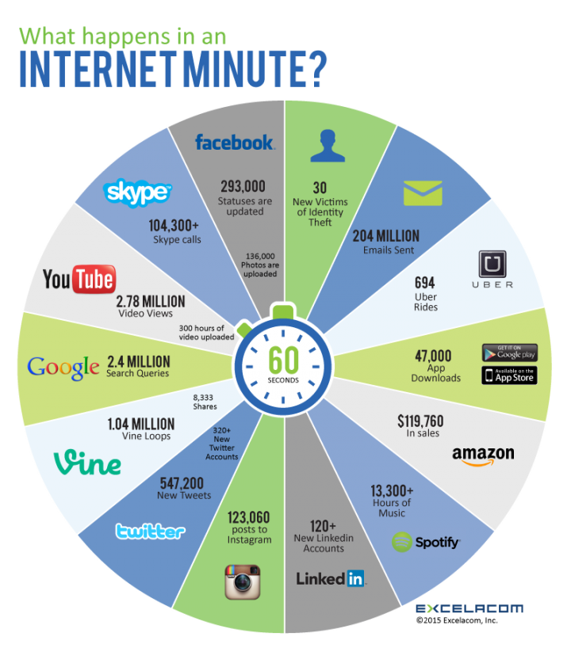
Notes:
This slide just focuses on the quantities of user generated data within a single minute. Consider the device driven data which is much, much more!

Slide 12








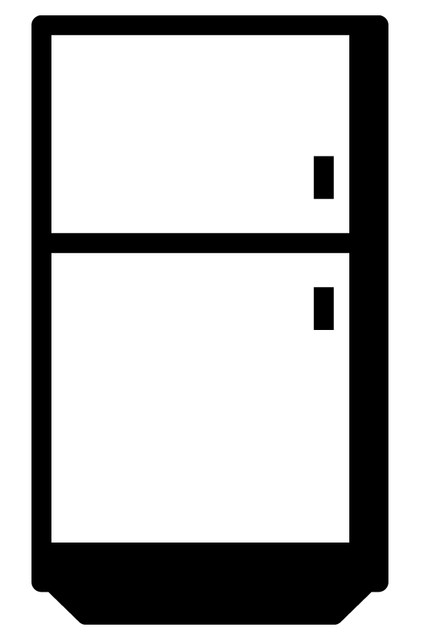



What About Devices?
2020 50B
Billions of Devices
2019 42.1B
50
2017 28.4B
2016 22.9B
2018 34.8B
40
2014 14.2B
2015 18.2B
30
2009 IoT Inception
20
2012 8.7B
1992 1M
2003 0.5B
10
2013 11.2B
0
1988
1992
1996
2000
2004
2008
2012
2016
2020
Notes:
The number of devices connected to the internet has already surpassed the global population. This trend will continue until there are an estimated 50 Billion devices… or approximately 6 devices per every single person on the planet!

Slide 13
Data Have Always Held Value
The more data, the greater the chance for value
But the more effort is required to extract that value!

Slide 14
Check Yourself
According to the author of this article, extracting value from big data is difficult. Why do you think this is so?
https://www.cioinsight.com/it-management/expert-voices/why-extracting-value-from-big-data-is-difficult.html

Slide 15
Relational Model Criticisms

Slide 16
Recall: Relational Database Systems
Data stored in two-dimensional tables with enforced schema meta-data
Data in tables are normalized to minimize redundancy and improve data consistency
Wide adoption and an abundance of tools
Support for SQL (Structured Query Language)
Writes are atomic, consistent, isolated, and durable
The de-facto standard—mature and proven

Slide 17

Every Data Problem Is a Nail, and the Relational Database Is the Hammer

Slide 18
One Size Does Not Fit All
There is no one database management system that can handle the complexity and variety of data found today.
This is why different systems exist to manage different types of data that vary in:
Structure
Size
Rate of change
We’ve learned the hard way that not all data problems are nails, and there is more than just the hammer.
Most relational database vendors are keen to this and now offer hybrid options, as we will see.

Slide 19
Three Criticisms of Relational
Rigid schema
Does not scale
Only for data at rest

Slide 20

Scalability

Slide 21
RDBMSs Don’t Scale Easily
Increases in data volumes and transactions per second lead to decreases in performance.
Companies “throw hardware at the problem,” buying vertical solutions like Oracle RAC or SQL Server MPP.
Companies hire specialists to set up clustering and improve performance through indexing, caching, and partitions.
“We can scale that for you, but you need to use the cloud” - Google Cloud Spanner, or MemSQL

Slide 22



DBMS Scaling: Up vs. Out
Vertical “Scale Up”
Horizontal “Scale Out”
Add more resources to an existing system running the service
Easier, but limited scale
Single point of failure
Run the service over multiple systems, and orchestrate communication between them
Harder, but massive scale
Overhead needed to manage nodes

Slide 23
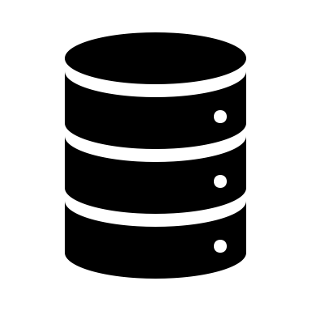
It’s very hard to scale out a relational database. But why?
Notes:
Week1 – slide 20 - Formatted with blank layout and the layout as per original. Font size taken as 42pts.

Slide 24
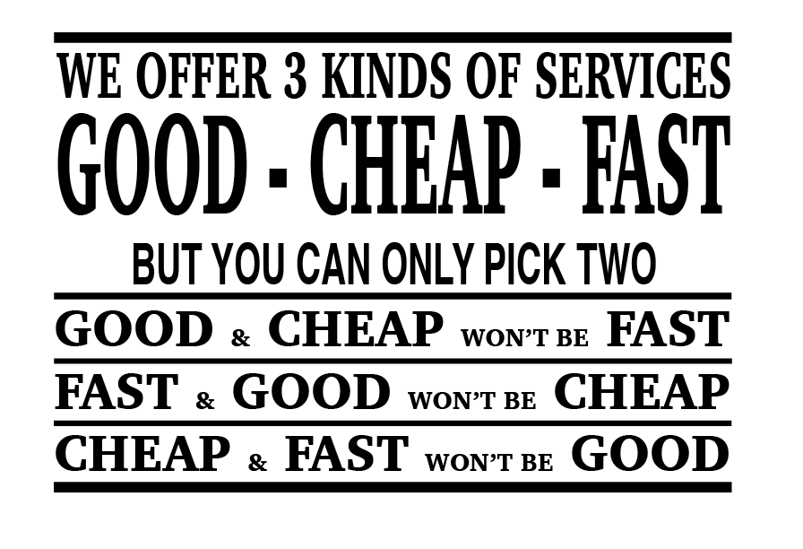

Slide 25
CAP Theorem of Distributed Data Stores
Eric Brewer: You can only have two of the following three guarantees:
Data consistency: all nodes see the same data at the same time
Data availability: assurances that every request can be processed
Partition tolerance: network failures are tolerated, the system continues to operate
Relational systems are designed to be consistent and available and therefore cannot be partition tolerant.
If I deposit money in an ATM that is disconnected from the network, how can my bank know about that deposit?

Slide 26
Why Can’t You Have It All?
Node 1
Node 2
Suppose we lose partition tolerance between nodes.
We must ignore any updates the nodes receive, or sacrifice consistency, or we must deny service until it becomes available again.
If we guarantee availability of requests, despite the failure:
We gain partition tolerance (the system still works) but lose consistency (nodes will get out of sync).
If we guarantee consistency of data, despite the failure:
We gain partition tolerance (again, system works) but lose availability (data on nodes cannot be changed, failure is resolved).
Notes:
http://www.infoq.com/articles/cap-twelve-years-later-how-the-rules-have-changed

Slide 27
Check Yourself - Matching
Adding additional resources to an existing system
A system continuing to operate in spite of a network failure
Assurances that data reads and writes can be processed
The ability for all data nodes to see the same data concurrently
Distributing a system over several network-attached computers
A. Scale out
B. Data availability
C. Data consistency
D. Scale up
E. Partition tolerance

Slide 28
CAP, ACID and BASE

Slide 29
Database Systems and CAP
Consistency
Partition
tolerance
Availability
Non-Distributed
Single-master
CA
CP
X
AP
Eventual consistency

Slide 30
CAP: All Kinds of Database Systems
RDBMSs like Oracle, MySQL, and SQL Server:
Focus on consistency and availability (ACID principles), sacrificing partition tolerance (and thus they don’t scale well horizontally)
Use cases: business data, when you don’t need to scale out
Single-master systems like MongoDB, HBase, Redis, and HDFS:
Provide consistency at scale, but data availability runs through a single node
Use cases: read-heavy; caching, document storage, product catalogs
Eventual consistency systems like CouchDB, Cassandra, and Dynamo:
Provide availability at scale but do not guarantee consistency
Use cases: write heavy, isolated activities: shopping carts, orders, social media

Slide 31
Single-Master (CP systems)
A leader node is responsible for orchestration of reads and writes.
Distributed, but single point of failure
leader
A
C
E
Notes:
For example reads and or writes are proxied through the leader who then distributes to A, B, or C

Slide 32
Eventual Consistency (AP systems)
A leader node is responsible for orchestration of reads and writes.
Distributed, but single point of failure
B
A
C
Notes:
For example reads and or writes are proxied through the leader who then distributes to A, B, or C

Slide 33
ACID vs. BASE
ACID
BASE
Atomic: Everything in a transaction succeeds, or the entire transaction is rolled back.
Consistent: A transaction cannot leave the database in an inconsistent state.
Isolated: Transactions cannot interfere with each other.
Durable: Completed transactions persist, even when servers restart and so on.
Basic availability: Data can be read and written to any node.
Soft-state: Nodes may change over time, even without direct updates.
Eventual consistency: At some point all nodes will have the same data.

Slide 34
The Goal
ACID on the individual nodes
BASE across the cluster

Slide 35
New SQL Slide TODO

Slide 36
Check Yourself
Come up with a specific use case or example where an eventual consistency system would not be a proper choice.
Notes:
Anytime you need real-time, concurrent consistency! E-ticketing?

Slide 37
The Rise of NoSQL

Slide 38
Why Stop at Scalability?
Let’s question everything about relational databases.
Metadata schemas are too rigid.
I don’t need my data normalized.
Integrity constraints and triggers are not necessary.
There is no need for ad-hoc queries or SQL. I know what I want out of the database.
Security? It can be handed in the application layer.
Relations do not suit my data well

Slide 39
The Rise of NoSQL
NoSQL == “not only SQL.”
It generally refers to a wide range of database systems that address the scalability and other challenges of the relational database model.
The entire point of NoSQL is that your need is not met by the relational model.
It is not an anti-SQL or anti-relational database movement, although it is perceived that way.
Not all problems are nails. Not all solutions are hammers!

Slide 40
Relational (SQL) vs. NoSQL
Relational SQL | NoSQL
Scales up | Scales out
CA | CA/AP/CP
SQL language | Custom DSL/API
ACID | BASE
Full indexes | Indexes only on keys
Rigid schema | Schema-less
Ad-hoc query capability | Pre-defined queries
This, of course, is a generalization, and the truth is somewhere in the middle.

Slide 41
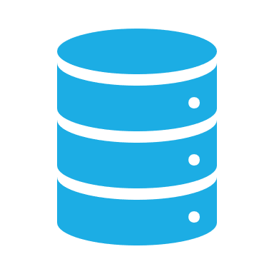
Data Models of NoSQL Databases

Slide 42
Data Models of NoSQL
Beyond row-oriented (relational), we have:
Key-value
Document stores
Column-oriented
Graph

Slide 43
Key-Value Stores
Basically a persistent hash map
Simple
Fast reads and writes
No secondary indexes
Use cases
Data model is simple
All you need is CRUD
Caching frameworks
Challenges
Difficult to perform complex queries
Products
DynamoDB, Riak, Redis

Slide 44
Columnar Stores
Data in tables are stored by column instead of by row
Storage not wasted on null values
Fast operations on columns such as aggregation of data
Use cases
Data analytics, big data
Timeseries data
Challenges
Key design is not trivial
Need to shard according to access patterns
Products
HBase, Cassandra, MemSQL

Slide 45
Document Stores
Nested structures of hashes and their corresponding values
Very flexible schema
No need to normalize
Use cases
Applications where the schema is likely to change
When you don’t need cross-cutting query concerns of relational
Challenges
Complex queries with joins are slow
Documents which reference themselves and other circular dependencies
Products
MongoDB, CouchDB, RavenDB

Slide 46
Graph Data Stores
Nodes and edges
Good fit for highly interconnected data
Allows for explicit relationships among data items
Use cases
When your data look like a graph or hierarchy
Challenges
Does not scale well horizontally
Very specific use cases—know when to use it!
Products
Neo4j, SQL Server Graph Tables

Slide 47
Relational Data Stores
Use cases
You need consistency checks and ACID compliance
You don’t know how the data will be queried
Data need to be normalized
Reporting
Challenges
Does not scale well horizontally
Products
Oracle, Postgres, SQL Server, MySQL

Slide 48
Check Yourself - Matching
Designed for fast reads/writes of simple CRUD operations
Good fit for interconnected data consisting of nodes and edges
Flexible schema as data is stored with no structure or little structure
Efficient storage where there are lots of null values and fast aggregate operations
A. Document
B. Key-Value
C. Graph
D. Column-Oriented

Slide 49

What is Big Data?

Slide 50
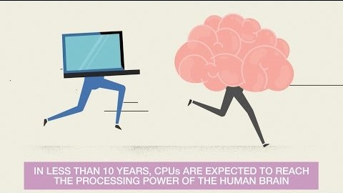

Slide 51
What Exactly Is Big Data?
It’s a buzzword for what we know already.
More data = more insights.
Machine learning models perform better with more data.
But there is an analysis gap because there’s too much data to sift through.
We need to scale this problem out, storing and processing the data over several distributed computers.
Then the CAP Theorem comes into play.

Slide 52
The V’s of Big Data And HAdoop

Slide 53
The Vs of Big Data
Volume | Velocity | Variety | Veracity
Data at Rest Terabytes to exabytes of existing data to process | Data in Motion Streaming data, milliseconds to seconds to respond | Data in Many Forms Structured, unstructured, text, multimedia | Data in Doubt Uncertainty due to data inconsistency and incompleteness, ambiguities, latency, deception, model approximations

Slide 54
Other Vs of Big Data
Viability: Can we predict results from the data? Can we determine which features serve as predictors?
Example: discovering patterns among customer purchase habits and unfavorable weather conditions
Value: What meaning can we derive from our data? Can we use it to make good business decisions?
Example: increase inventory levels of potato chips two weeks before the Super Bowl

Slide 55
Examples: Big Data Applications
Clickstream: Analyze website traffic to determine how to invest in site improvements.
Sensor data: Collect data from environmental sensors to identify foot-traffic patterns in a retail store (IoT).
Geographic data: Analyze online orders to establish consistency between where products are shipped vs. where they are ordered.
Server logs: Identify potential intrusions and misconfigured firewalls.
Sentiment: Get a sense of brand through social media.
Unstructured: Detect potential inside trading though email, and phone conversations.

Slide 56
Hadoop Big Data Systems
Hadoop is an ecosystem of several tools:
HDFS: Hadoop Distributed File System
Map-Reduce: a batch, parallel processing framework
YARN: Yet Another Resource Negotiator; for job/memory management
Hadoop’s Manta: distribute the data and take the processing to it
CP and AP systems

Slide 57
Check Yourself - Matching
How suitable is the data for machine learning and AI?
The amount of data arriving in a given point in time is too much to process.
The data itself is ambiguous or incomplete.
The type of data varies, making it time consuming to process.
The quantity of data is too large to process.
What insights can we derive from our data?
A. Volume
B. Value
C. Viability
D. Veracity
E. Variety
F. Velocity

Slide 58

Data Abstraction Levels and DBLC

Slide 59
Data Abstraction Levels
Conceptual
Independent of data model, software, and hardware
Logical
Dependent on a data model (relational, OO, graph)
Hardware and software independent
Implementation
Dependent on data model and software (SQL Server, MongoDB)
Hardware independent
Physical
Dependent on data model, software, and hardware

Slide 60
Data Abstraction Tooling
Conceptual
“Customer orders product,” Chen ERD
Logical
Logical ERD, IDEF1X diagram, or UML class diagram
Implementation
Code to build SQL tables and schema in chosen application (MySQL, SQL Server, etc.)
Physical
Actual tables on a DBMS and how they are implemented on disk

Slide 61
Systems/Database Development Lifecycle
I Planning | II Analysis | III Design | IV Implementation | V Maintenance and Support
Resources
Logical Model
Conceptual Model
Physical Model
Implementation Model
Time

Slide 62
Check Yourself
Conceptual Data Modeling with ERD’s is part of which phase of the DBLC?
Implementation
Design
Planning
Analysis

Slide 63
Application Layers

Slide 64
Layers of a Modern Data-Oriented Application
Presentation
Code and layout responsible for the user interface
Business Logic
Data Access
Create, read, update and delete (CRUD) operations
Database
Transformational logic at the heart of what the application actually does
Data storage and retrieval

Slide 65
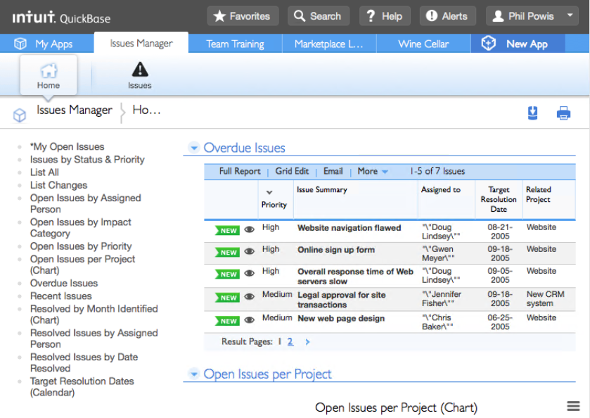
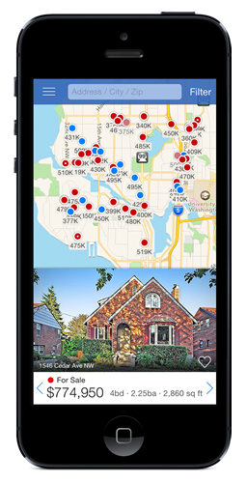
Presentation Layer
User interface concerns
Web: HTML and CSS
Mobile: Xcode interface builder/ Android studio
Notes:
Any code responsible for user interface concerns is considered the presentation layer. In web applications the presentation layer is HTML and CSS. In mobile you build the layout using tools like Xcode or Android studio.

Slide 66
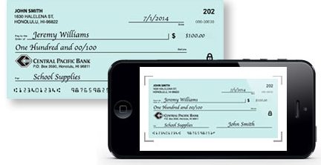
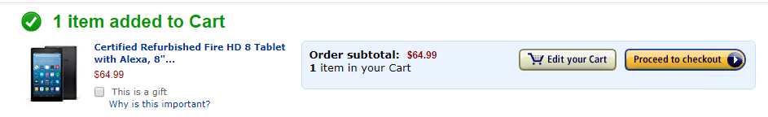
Business Logic Layer
Main transformational logic of the application; part of the application’s functionality
Written in a programming language: Java, JavaScript, Python, C#, and so on

Slide 67
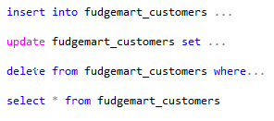
Data Access Layer
Responsible for CRUD operations
Typically, this is code that transforms operations into the DSL (domain-specific language) to communicate with the database (typically SQL)

Slide 68
Check Yourself
The part of the application responsible for the primary behavior and functionality of the application is the
Presentation Layer
Business Logic Layer
Database Itself
Data Access Layer

Slide 69
Scaling Up and Middleware

Slide 70



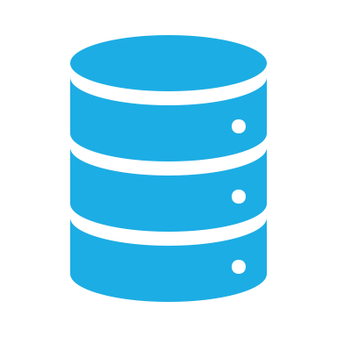
Scaling Up
Presentation
Presentation
Business Logic
Business Logic
Scale Up
Network + Middleware
Data Access
Database
Data Access
Database
Notes:
We scale up data-oriented applications by separating the layers of the application into their own independent services which communicate over the network.
This allows more users to access the application, yet introduces some design complexity.
ADVANCE SLIDE
When an application’s layers are segmented we must introduce middleware between the applications of each layer in order for them to communicate. For example we might use ODBC middleware so that the data access layer can communicate with the database itself. Or in the case of the diagram you see an ODATA REST API so that the business logic can communicate with the data access layer.

Slide 71
Middleware
Middleware is software that provides communications between the layers of an application.
It is required whenever an application is split into layers over a network.
There are different types of middleware for access between the different layers.
Notes:
Soap – simple object access protocol, ODBC -open database connectivity, ODATA -

Slide 72
Middleware Alphabet Soup
Name | What It Is/What It Does
ODBC (open database connectivity) | Database management systems access
CORBA (common object request broker architecture) | Business logic procedure call and data exchange
REST (representational state transfer) | A “pattern” that uses HTTP protocol for business logic/data exchange; foundation of most web APIs
SOAP (simple object access protocol) | Like REST but more overhead/payload
ODATA (open data protocol) | A spec for CRUD over HTTP using the REST patterns

Slide 73
Monolithic and 2-Tier Client/Server

Slide 74
Different Application Environments
Monolithic
Monolithic + distributed storage
Two-tier client-server
Three-tier client-server
N-tier client-server
Microservices

Slide 75
A Monolithic Application
All layers within a single system
Simplest design
Single-user, single-site, no scale
Example: A To-Do application on your phone
Presentation
Business Logic
Data Access
Database

Slide 76
Monolithic Over Network Storage
Data storage is over a network, but the rest of the application is monolithic
Single-user, multi-site
Example: Same To-Do application that saves to cloud storage
Presentation
Clients
Business Logic
Data Access
File Storage
Data
Notes:
For example if you place a Microsoft access database in a cloud file sharing service like drop box, more than one user can access the database, but you still need the MS Access application to use the database and drop box does not handle concurrency issues for you like when more than one person updates the data at the same time.

Slide 77
Two-Tier Client-Server
In a two-tier client-server, the application is in two parts separated by one layer of middleware
Multi-user, multi-site
Common architecture in the pre-consumer Internet era
Presentation
Business Logic
Network + Middleware
Data Access
Data

Slide 78
Where Is the Business Logic?
“Thin Client”
“Fat Client”
Clients
Presentation
Presentation
Network + Telnet (example)
Clients
Business Logic
Data Access
Business Logic
Network + ODBC (example)
Server
Data Access
Server
Database
Database
Notes:
Thin clients might use display only middleware protocols like RDP, Telnet or SSH. The presentation layer simply draws the screen and handles input. The rest of the application runs on a single server. Thin clients are easier to maintain as the business logic (and therefore most of the code) is found in one place on the server.
Fat clients have most of the application on the client and only the database is on the server. For example you might create a window application which writes to SQL Server or MySQL using ODBC.
Thin clients do not scale as well as fat clients as most of the work is being on expensive server hardware. Fat clients are more difficult to maintain than thin clients as the application codebase is installed on every client.

Slide 79
Check Yourself
What is the fundamental difference between a thin client and a fat client?

Slide 80
3-Tier, N-Tier and Microservices

Slide 81
Three-Tier Client-Server
In a three-tier client-server, the application is split into three parts, typically with a business logic and data access layer in the middle tier
Multi-user, multi-site
Gets around the limitations of fat/thin clients
Majority of business logic is on the server
Common architecture just before the Internet boom
Presentation
Clients
Business Logic
Network + CORBA (example)
Server
Business Logic
Data Access
Network + CORBA (example)
Server
Database
Notes:
There needs to be some business logic in the client, mainly to package up messages to be sent to the server.

Slide 82
Web Three-Tier Example (WordPress)
Presentation
HTML/CSS
Browser
Business Logic
JavaScript
HTTP/HTTPS
Business Logic
Apache + PHP
Server
Data Access
PHP ezSQL
ODBC
Server
Database
MySQL

Slide 83
Web as Middleware and Microservices
The Internet ushered in major changes for application development.
The SOAP and REST protocols over HTTP made it easy for developers to divide up the layers of their application and split business logic into manageable microservices.
These microservices manage a single responsibility, making the application easier to update and manage.

Slide 84
N-Tier/Microservices
Clients
Browser
Presentation
Mobile App
Presentation
Business Logic
Business Logic
HTTP REST
Web API
Business Logic
HTTP REST
Business Logic
Business Logic
Services
Servers
…
Data Access
Data Access
ODBC
ODBC
Data
Database
Database

Slide 85

The NoSQL Solution?
Notes:
No!
In the same way relational is not the solution.
Hammer. Nail.

Slide 86
The World Is Converging
Microsoft SQL server is a relational database but has adopted many of the features found in NoSQL databases.
In memory tables for basic CRUD operations
Columnstore indexes for time series data
Document database for no-schema
Graph databases
Temporal tables for tracking changes to data
Connectors to query big data with SQL

Slide 87
So How Do You Choose?
What type of data model is it? Graph? Timeseries? Real-time? Historical?
Do you need a schema? Does it require schema on write or on read?
Would you benefit from integrity constraints and indexes?
Do you have cross-cutting query concerns?
Do you need to scale out?

Slide 88
Don’t Settle for One— Polyglot Persistence!
For example:
Product catalog and blog in MongoDB
Redis for your shopping cart and web page cache
Cassandra for audit and activity logs
MySQL for order processing and payments
Hadoop for data analytics
Neo4j for your social graph
Hammer. Nail. Screwdriver. Screw. Use the right tool for the job!

Slide 89
Polyglot Persistence
Pros
Cons
There is better performance and scalability.
It is cloud friendly in today’s world of microservices.
Using the best tool for the job! Stop forcing that square peg into that round hole!
No interoperability: You must connect the databases together.
You must decide where data should be stored.
There is increased complexity and administrative burden.
Notes:
In the This is the future. In

Slide 90

Where Will We Go in This Course?

Slide 91
This Course Consists of Three Parts
Advanced Relational Databases
Hadoop and Big Data
NoSQL

Slide 92
Advanced Relational Databases
Programming
Database administration
Transactions
Concurrency control
Performance
Security
NoSQL features of the RDBMS (document, graph, column store, temporal)

Slide 93
Hadoop and Big Data
Big data architecture
HDFS
MapReduce
Pig
Flume
Sqoop
Oozie
Hive
Impala
HBase
Solr

Slide 94
NoSQL
MongoDB
Cassandra
Redis
Kafka

Slide 95

Questions?

